Slide 1
EE366 Final Project “Home Irrigation System”
Student Name | Student KAU ID
Mahdi Bathallath | 2236809
Faisal Algadi | 2135678
Instructor: Dr.Wassim Alzouch
Section: HA

Slide 2
Agenda
Introduction
Circuit Design
Flowchart
Simulation Pictures (Proteus 8)
Project Pictures

Slide 3
Introduction
A wiseman once said: “If you mastered the microcontroller, you can control anything” (Dr.Wassim Alzouch)
Our project helps to monitor the soil humidity level.
Automatically provide the soil with some water when it gets dry.
Notify the user through an e-mail with the moisture level.
Allow the user to manually control the pump that waters the soil.

Slide 4
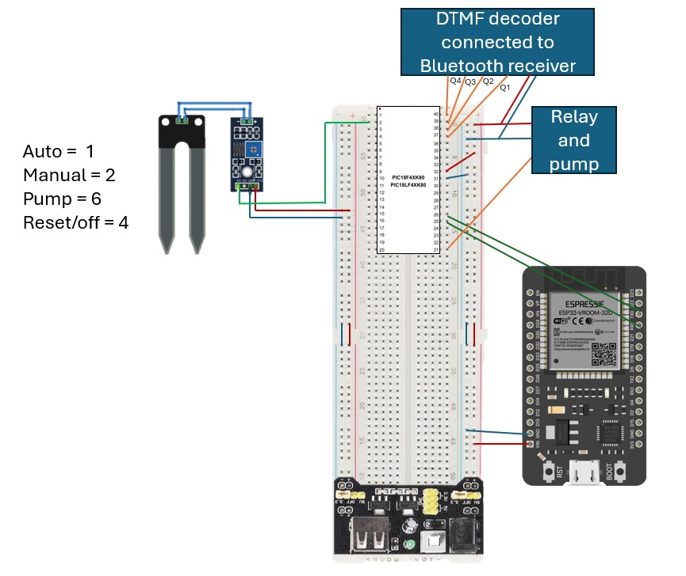
Circuit Design

Slide 5
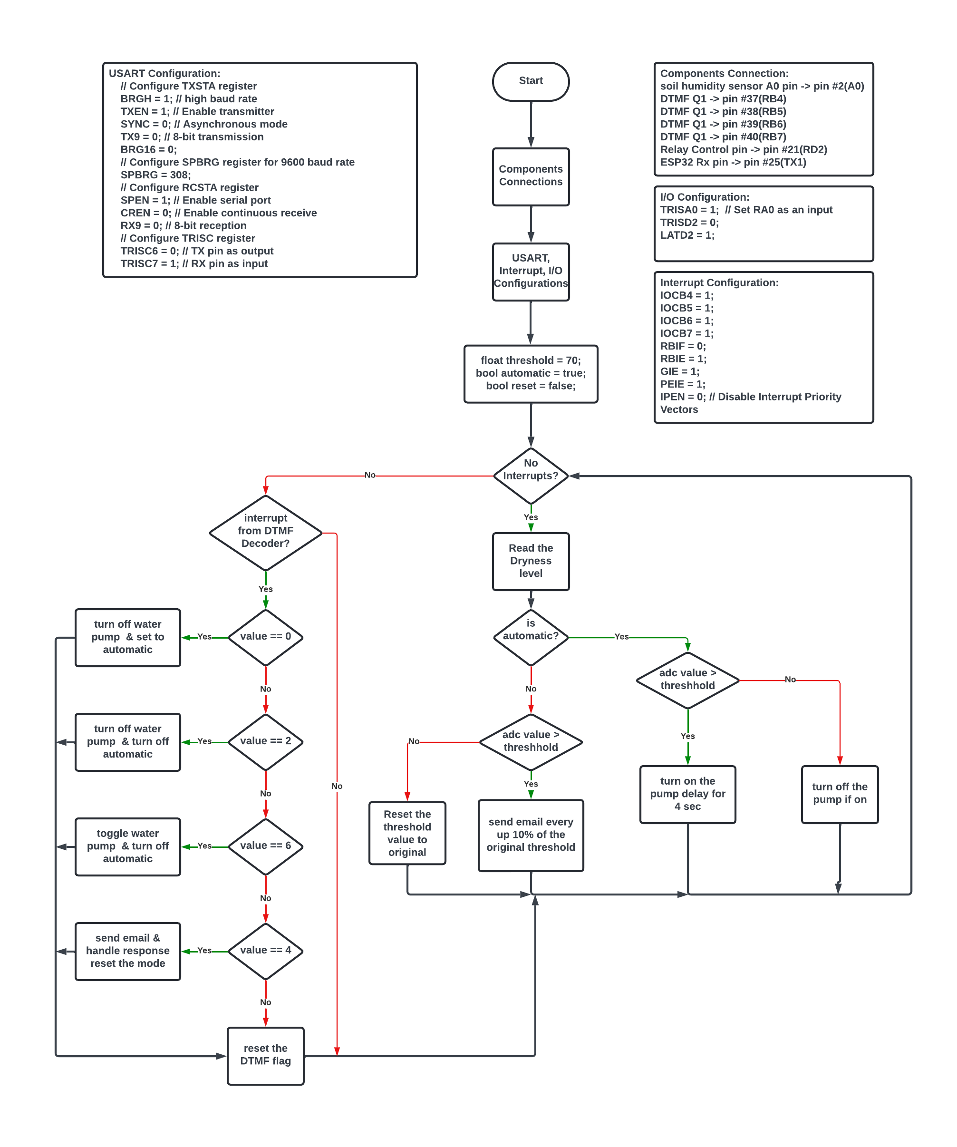
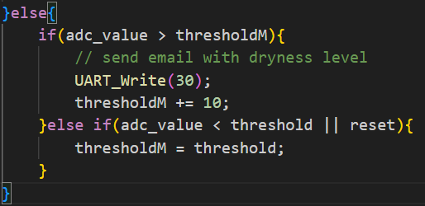
Flowchart
If the manual mode is on, an e-mail will be sent every +10 of the threshold if the soil was still dry.

Slide 6
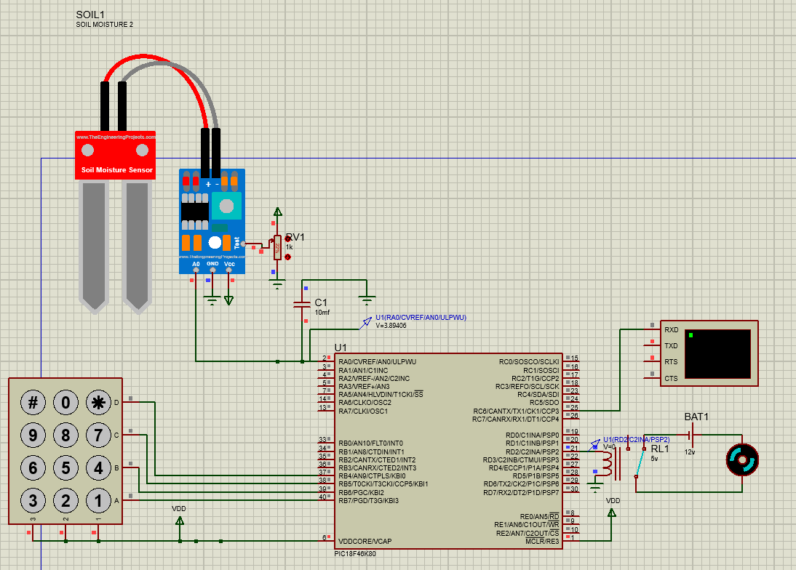
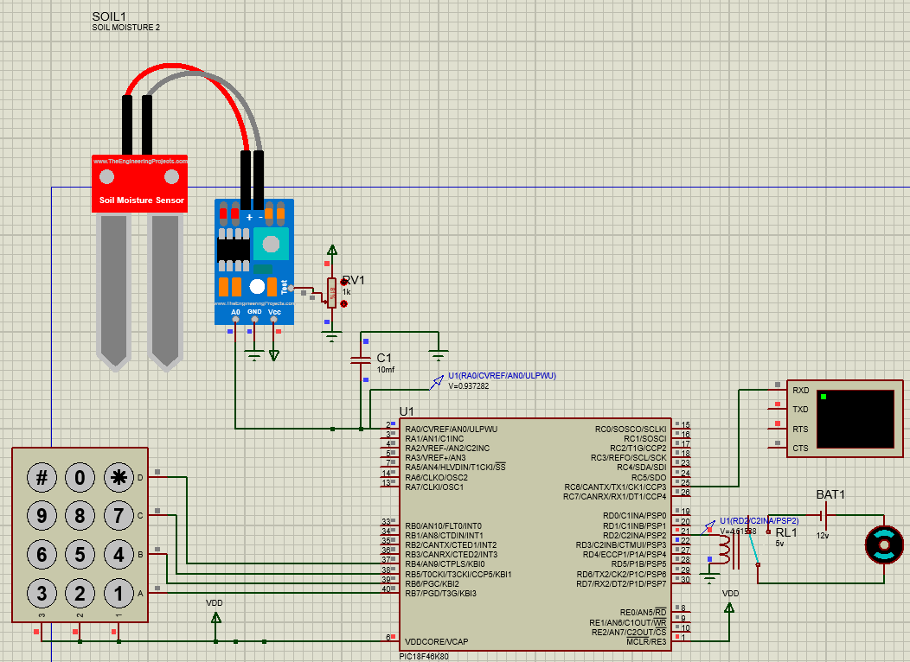
Simulation Pictures (Proteus 8)
Low Humidity (Water Pump = ON)
High Humidity (Water Pump = OFF)

Slide 7
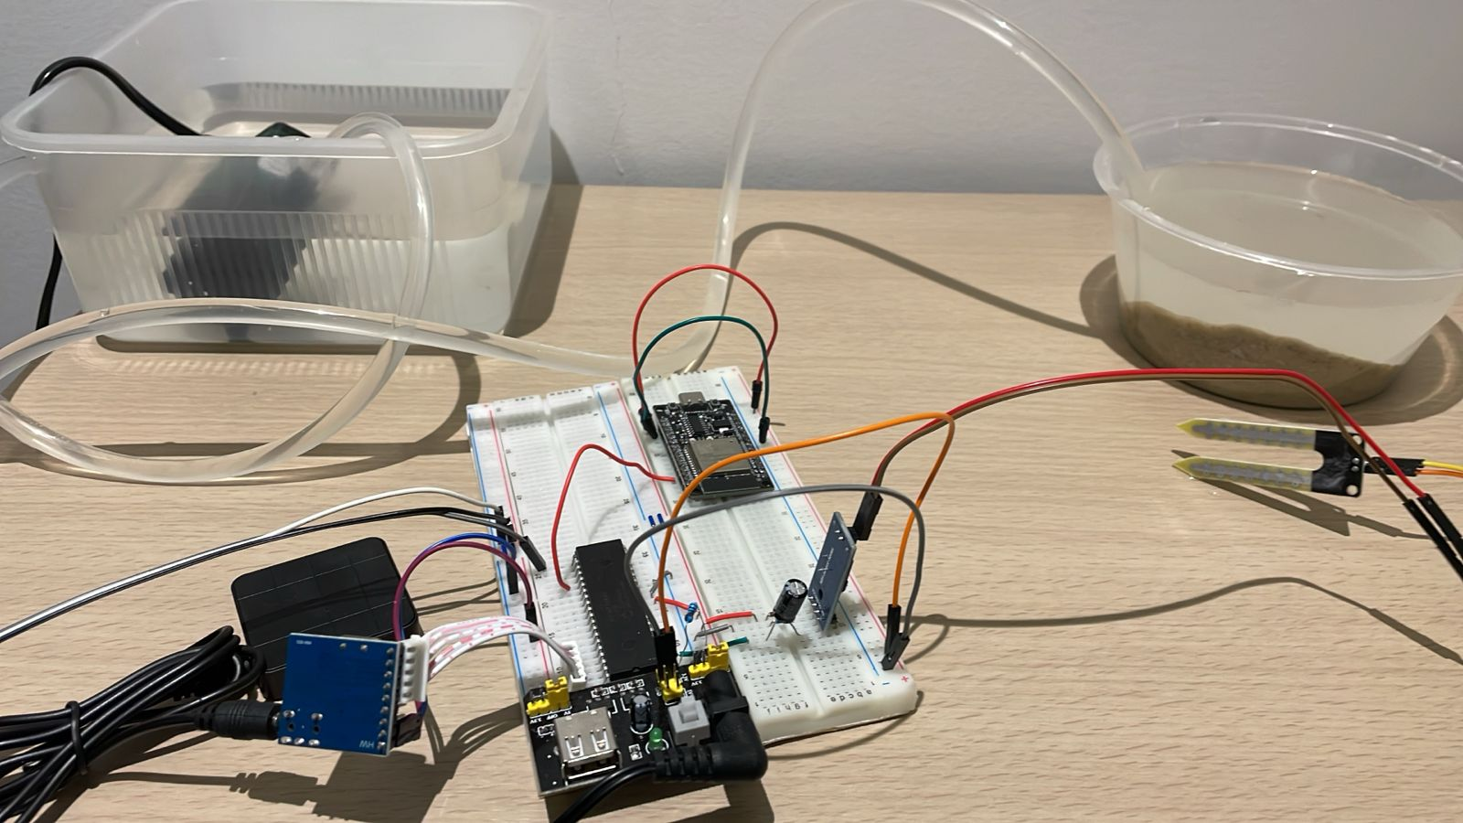
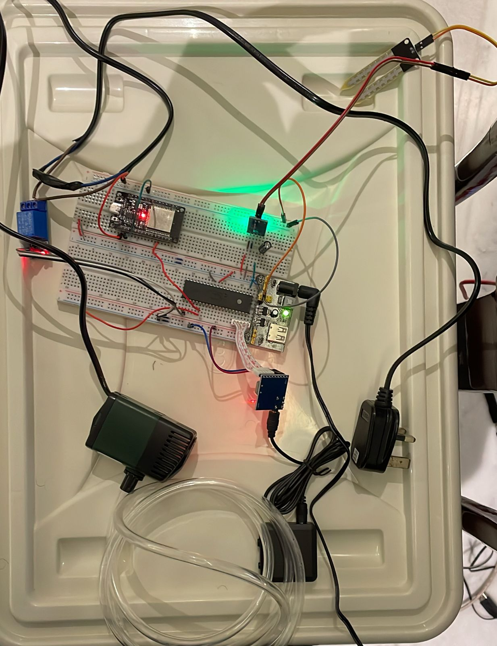
Project Pictures

Slide 8
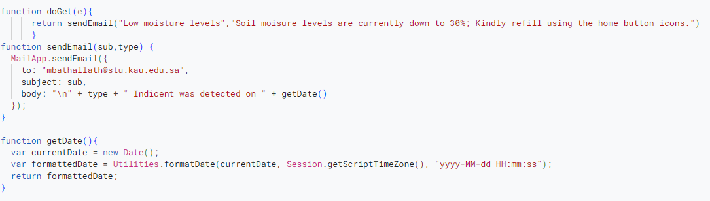
Project Pictures (Apps Script Server)

Slide 9
Thank you

